Slide 1
Default prediction model
Bene
Shinan

Slide 2
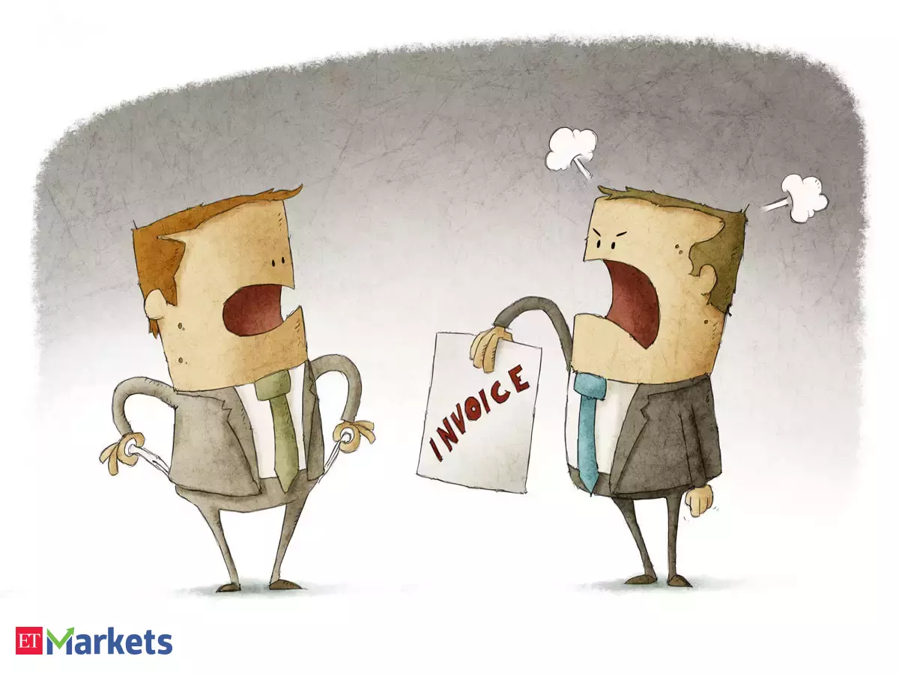
Default Risk

Slide 3
Default Risk

Slide 4
Heatmap

Slide 5
Who will default?

Slide 6
Default Prediction

Slide 7
Further Development

Slide 8
Input briefing
End

